Slide 1


Croatia in Superlatives Croatia in Numbers
ACROSS CULTURES

Slide 2

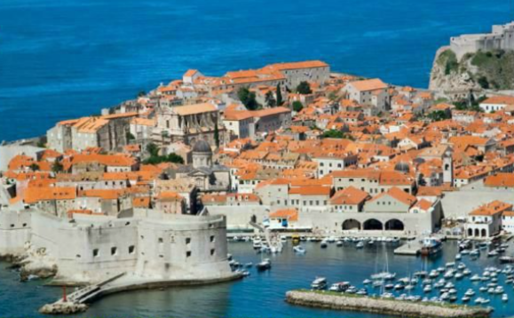
Watch the video Croatia – Full of life. Describe the meaning of the title. Draw a mind map. Present it to the class.
Croatia
?
?
?
?
Talk about Croatia in English. Imagine you are talking to some tourists. Introduce Croatian famous sights and culture. Use words from your mind map.

Slide 3
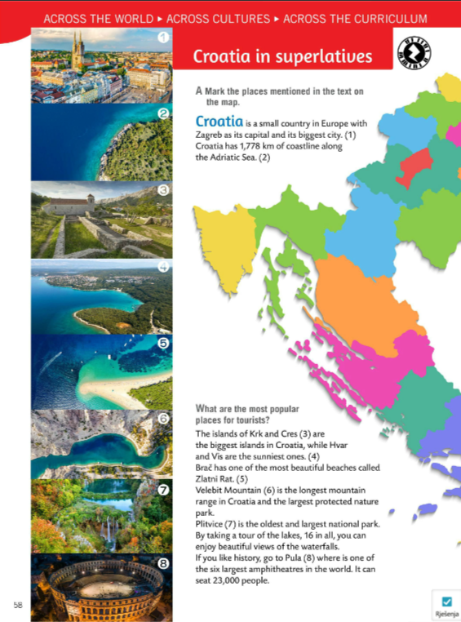
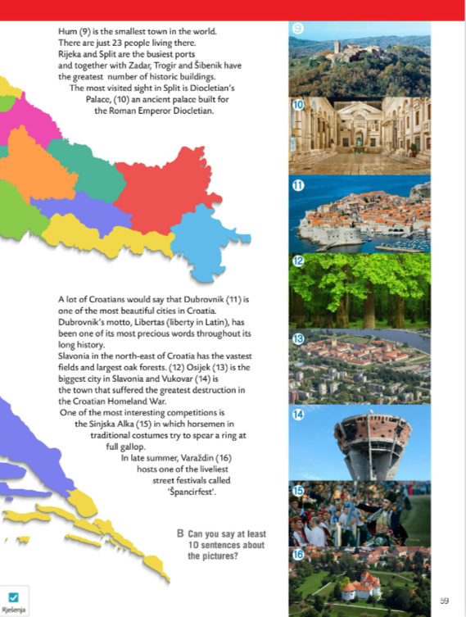
Look at the map of Croatia.
Read the text in your book.
Do Task A. Mark the places mentioned in the text on the map.

Slide 4
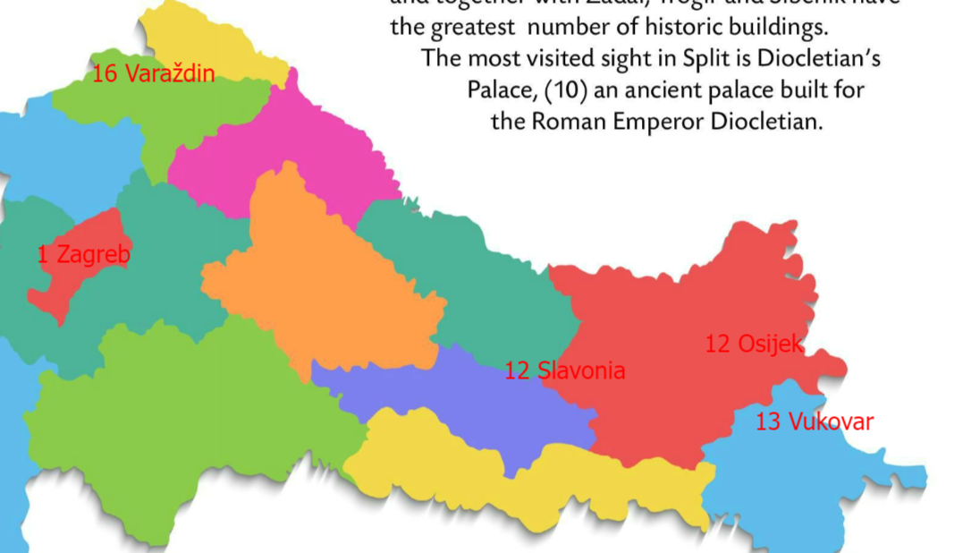
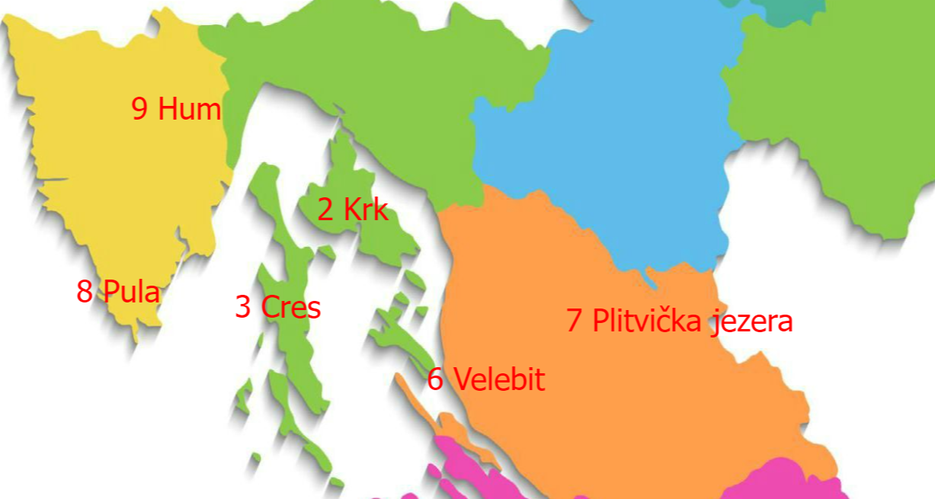
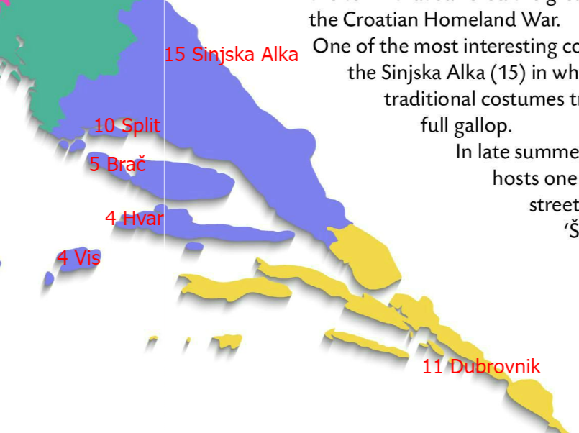
Check!

Slide 5
Look at the pictures 1 to 16.
Choose ten places and write one sentence about each place.
Check in class.

Slide 6
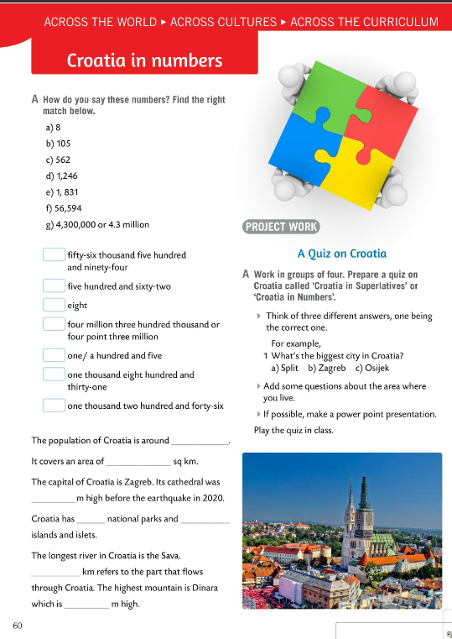
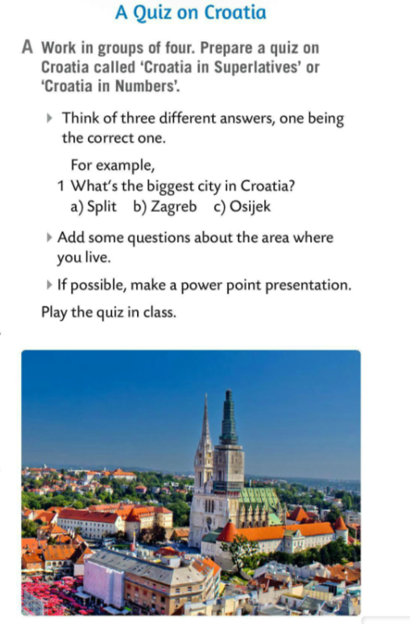
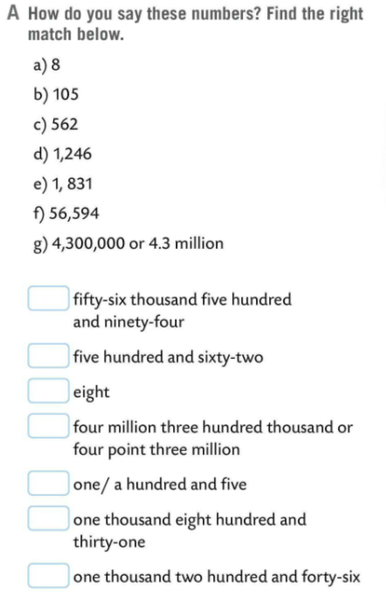
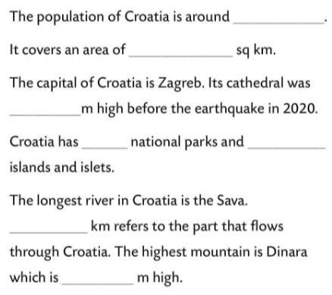
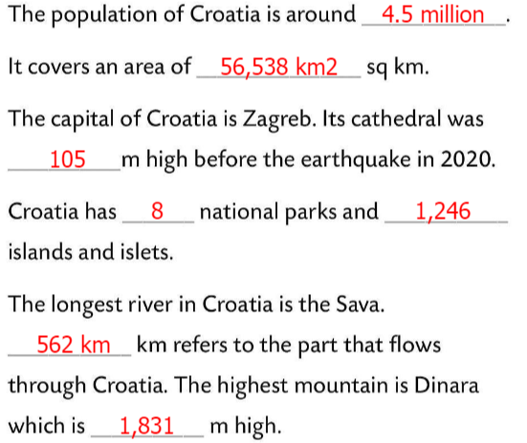
How do you say numbers in Task A? Find the right match.
Check.
Fill in the sentences with the numbers above.
f)
Check.
c)
a)
Work in groups of four.
Prepare a quiz on Croatia called ‘Croatia in Superlatives’ or ‘Croatia in Numbers’.
Read the instructions in Task A and play the quiz in class.
g)
b)
e)
d)

